Slide 1

GRAPH DATA STRUCTURE
LESSON 19
NANODEGREE → ENGINEERING MODULE

Slide 2

AGENDA
01 Introduction to Graph Data Structure
02 Types of Graphs
03 Graph implementation
04 Practice and Exercises

Slide 3


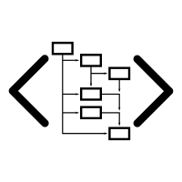
GRAPH DATA STRUCTURE
INTRODUCTION
HIGH LEVEL OVERVIEW

Slide 4
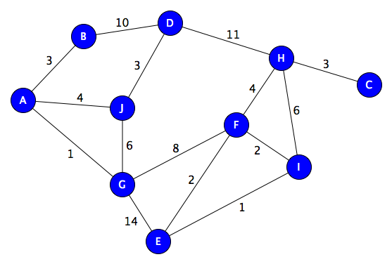
GRAPH STRUCTURE
A GRAPH consists of a finite set of vertices or nodes and a set of edges connecting these vertices.
Two vertices are said to be adjacent if they are connected to each other by the same edge..

Slide 5
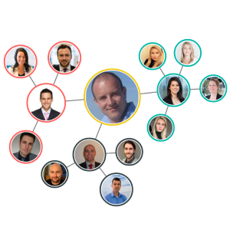
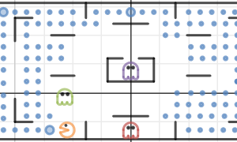
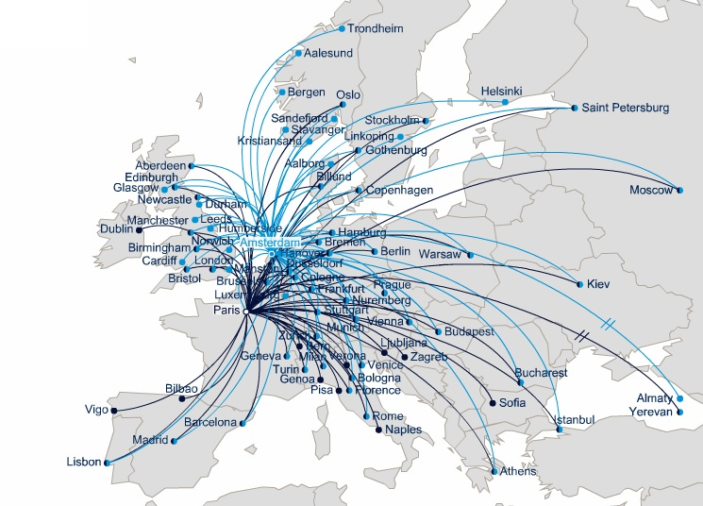
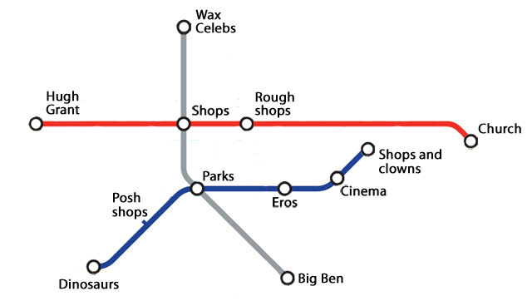
GRAPH LIFE EXAMPLES
Social media
Games
Travel maps
Many more!

Slide 6
GLOSSARY
Order: The number of vertices in the graph
Size: The number of edges in the graph
Vertex degree: The number of edges that are incident to a vertex
Isolated vertex: A vertex that is not connected to any other vertices in the graph
Self-loop: An edge from a vertex to itself
Directed graph: A graph where all the edges have a direction indicating what is the start vertex and what is the end vertex
Undirected graph: A graph with edges that have no direction
Weighted graph: Edges of the graph has weights
Unweighted graph: Edges of the graph has no weights
Graph cycle: a cycle occurs when three or more vertices in the graph are connected so as to form a closed loop
Acyclic graph: a graph that has no cycles
Cyclic graph: a graph that has at least one cycle
Connected graph: graph is connected if for every pair of vertices in the graph there is a path of one or more edges connecting the given vertices.
These are key definitions that we need to know in relation to GRAPHs

Slide 7
BREADTH-FIRST SEARCH
BFS
Starts at a particular vertex and explore all of its neighbours at the present depth before moving on to the vertices in the next level.
EXAMPLES
Used to determine the shortest paths and minimum spanning trees.
Used to search on social networks.

Slide 8
DEPTH-FIRST SEARCH
DFS
Starts from a particular vertex and explore as far as possible along each branch before retracing back (backtracking).
EXAMPLES
Used to find a path between two vertices.
Used to detect cycles in a graph.
Used in topological sorting.
Used to solve puzzles having only one solution (e.g., mazes)

Slide 9
SHORTEST PATH
SHORTEST PATH
The shortest path from one vertex to another vertex is a path in the graph such that the sum of the weights of the edges that should be travelled is minimum. (Dijkstra’s shortest path algorithm, Bellman–Ford algorithm)
EXAMPLES
Used to find directions to travel from one location to another in mapping software like Google maps or Apple maps.
Used in networking to solve the min-delay path problem.

Slide 10
CYCLE DETECTION
CYCLE
Path in a graph where the first and last vertices are the same. If we start from one vertex, travel along a path and end up at the starting vertex, then this path is a cycle.
EXAMPLES
Used in distributed message-based algorithms.
Used to detect deadlocks in concurrent systems.

Slide 11

DEMO &
EXERCISES
Implementing GRAPHS
EXERCISES & PRACTICE

Slide 12
THANK YOU!

